Slide 1
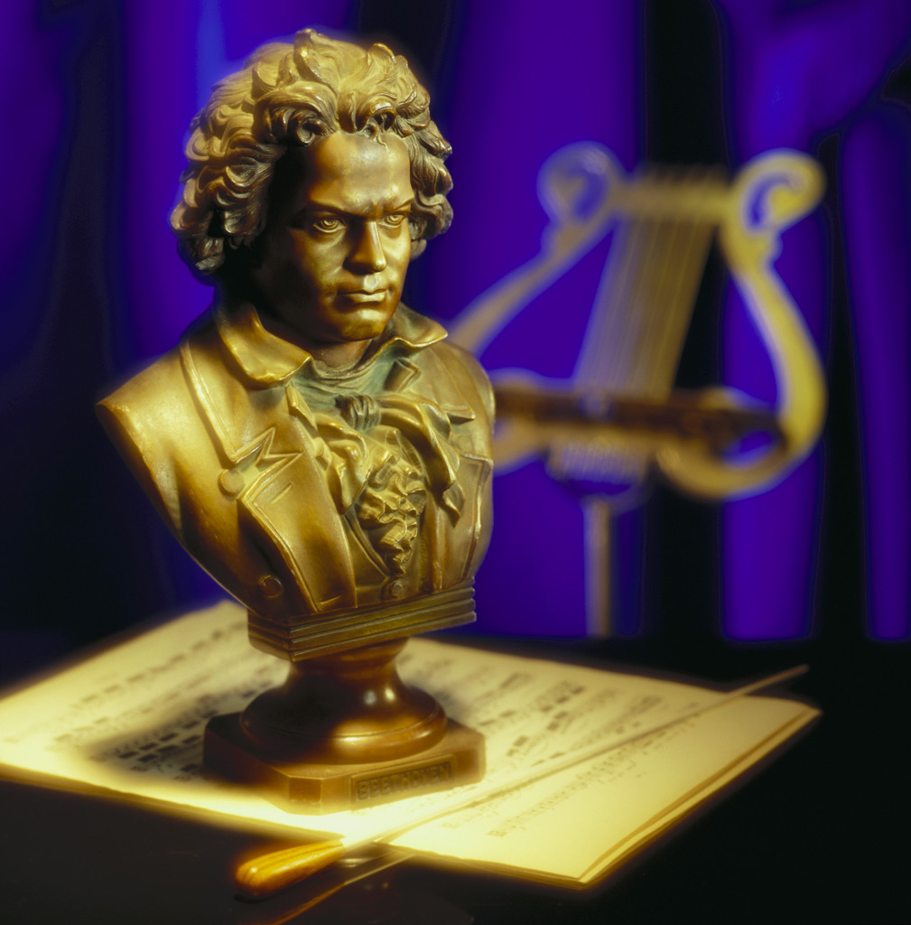

Composers
Historical Periods of Music and their
By Peggy Ashland Taylor

Slide 2
Historical Periods of Music
Baroque
Classical
Romantic
Impressionist
20th & 21st Centuries

Slide 3
Baroque
Bach
Scarlatti
Handel
Telemann
Rameau
Frescobaldi
Corelli
Vivaldi
Purcell

Slide 4
Baroque Characteristics
Polyphonic Texture
Use of Ornamentation
Dance Suites
Limited Use of Dynamic Markings
Terraced Dynamics

Slide 5
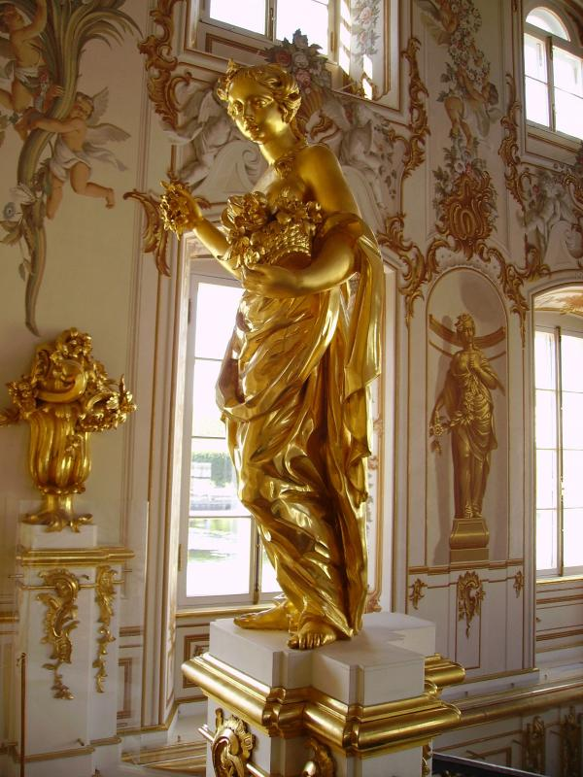
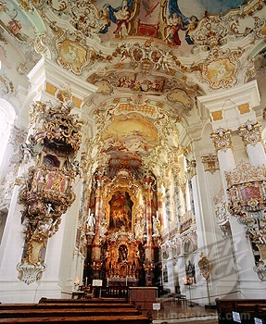
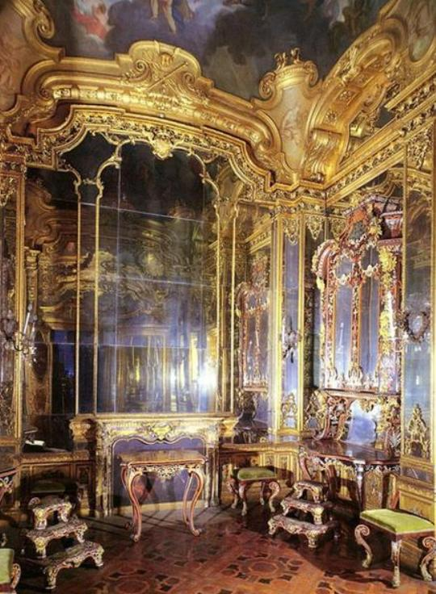
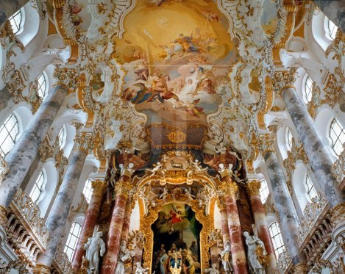
Baroque Architecture

Slide 6
Classical
Mozart
Haydn
Beethoven
Clementi
Kuhlau
Diabelli
Czerny

Slide 7
Classical Characteristics
Homophonic texture
Cadence points obvious
Sonata/Sonatina Form Developed
Alberti Bass

Slide 8

Classical Architecture

Slide 9
Romantic
Chopin
Schumann
Schubert
Brahms
Grieg
Tchaikovsky
Liszt
Burgmuller

Slide 10
Romantic Characteristics
Programmatic Music w/Descriptive Titles
Colorful Harmonies w/Altered, Unusual Chords
More Chromaticism
Lyrical Melodies

Slide 11

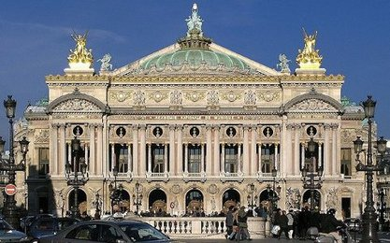
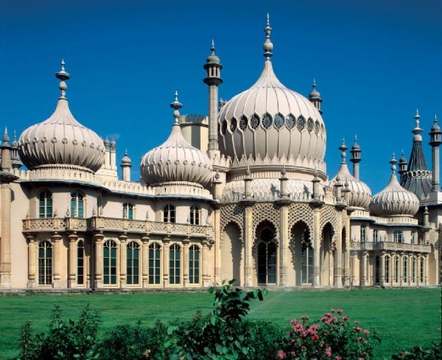
Romantic Era Architecture

Slide 12
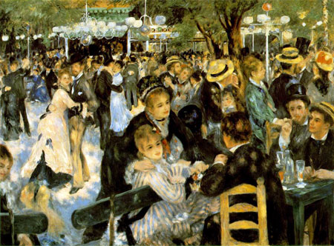
Impressionist
Debussy
Ravel
Griffes

Slide 13
20th & 21st Century Composers
Bartok
Kabalevsky
Prokofiev
Shostakovitch
Dello Joio
Copland
Britten
Poulenc
Musczynski

Slide 14
20th & 21st C. Characteristics
Atonality, Bitonality, Polytonality
Irregular and Changing Time Signatures
Polyphonic Texture again (some)
Sonata and Suite Forms again

Slide 15

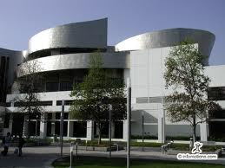
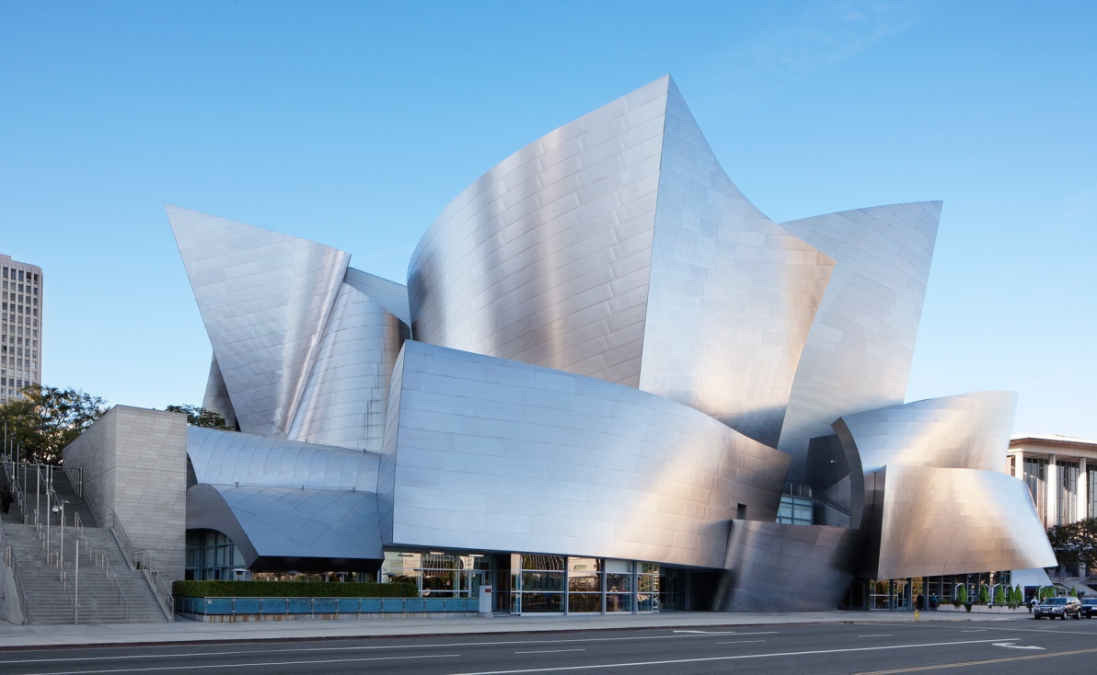
20th-21st Century Architecture

Slide 16
The End

